Slide 1
DSAI MINI PROJECT
Presented By:
Trisha Bankata Mishra (U2222358J)
Randall Chiang (U2222099A)
Leo Kee Soon Gary (U2222411L)

Slide 2
TABLE OF CONTENTS
01
02
03
04
05
INTRODUCTION
A brief glance into the dataset and problem statement
DATA CLEANING
How we cleaned the dataset
EXPLORATORY DATA ANALYSIS
Analysis of the dataset
MACHINE LEARNING MODEL
Analysis of the dataset
CONCLUSION
What we found from our analysis

Slide 3
INTRODUCTION
We selected a dataset on NBA players and the factors that might be affecting their performance through kaggle that had varied data, and ample data to choose from.
We chose our response variable as the net rating which is how much better or worse a team is when a specific player isn’t on the court.
We found out the correlation between various different factors of players to the net rating, as provided in the dataset.

Slide 4
PROBLEM STATEMENT:
To find out the relation between a player's personal stats and attributes to their team performance.

Slide 5
DATA CLEANING:
We used data cleaning techniques to get rid of unnecessary data, to make our dataset more comprehensive and relevant.

Slide 6
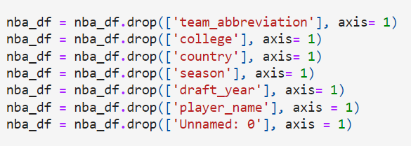
DATA CLEANING TECHNIQUES:
DROP UNNECESSARY COLUMNS
DATA BINNING
We then split personal attributes into ranges to simplify the data and make it easier to understand.
We also removed ‘NaN’ values, removed undrafted players.
We labelled data using bins to calculate correlation value. It improves the readability and clarity.
.
First, we dropped columns that didn’t contribute to the dataset, such as name,college, season, etc. This reduced the number of columns and cleaned up the dataset a bit.

Slide 7
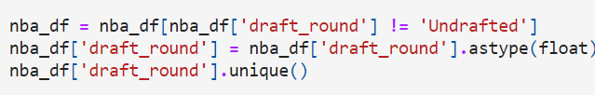
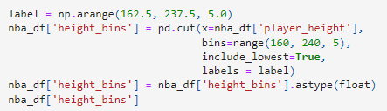
2. DATA BINNING
We also removed ‘NaN’ values, removed undrafted players.
We labelled data using bins to calculate correlation value. It improves the readability and clarity.

Slide 8
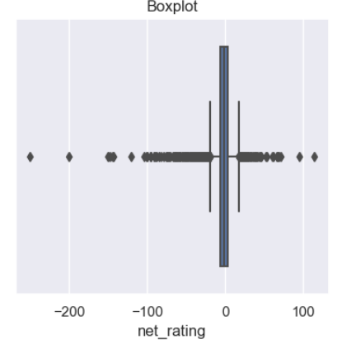
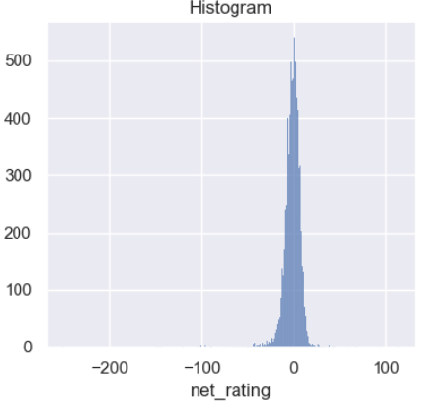
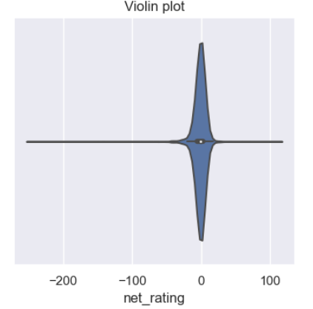
Exploratory Data Analysis
Visuals of Net_rating
From the graph, we can tell that the net_rating is extreme skewed

Slide 9
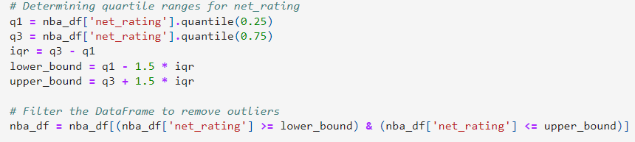
Exploratory Data Analysis
Removal of Outliers
Using the interquartile range method

Slide 10
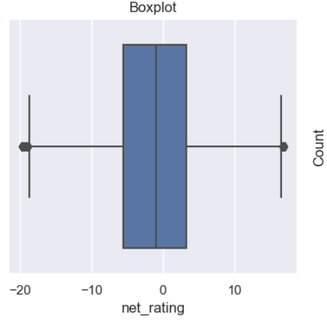
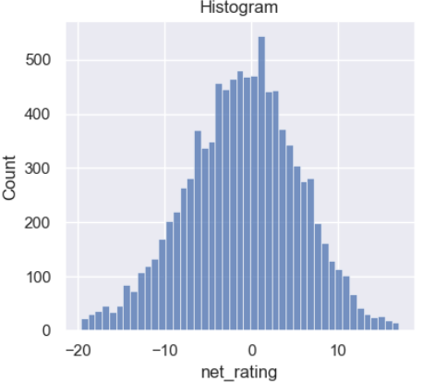
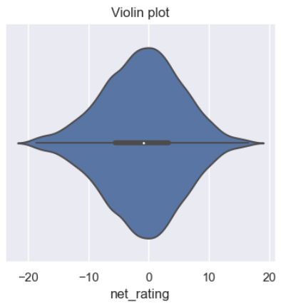
Exploratory Data Analysis
Improved Net_rating graph

Slide 11
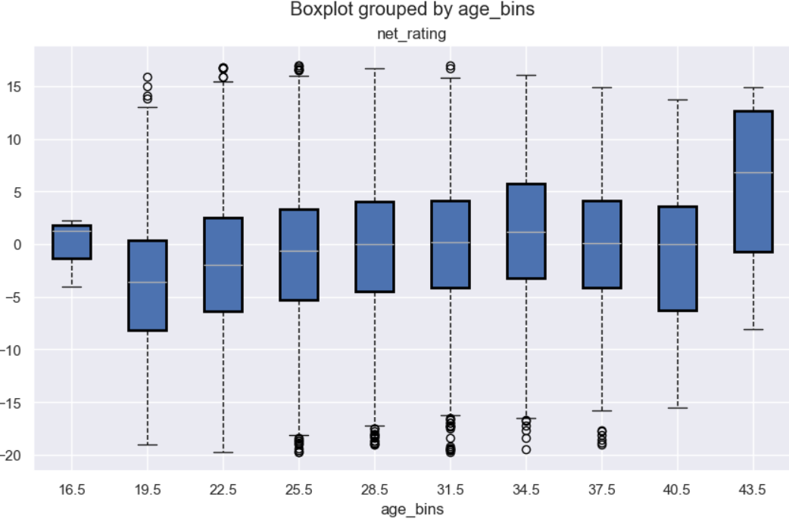
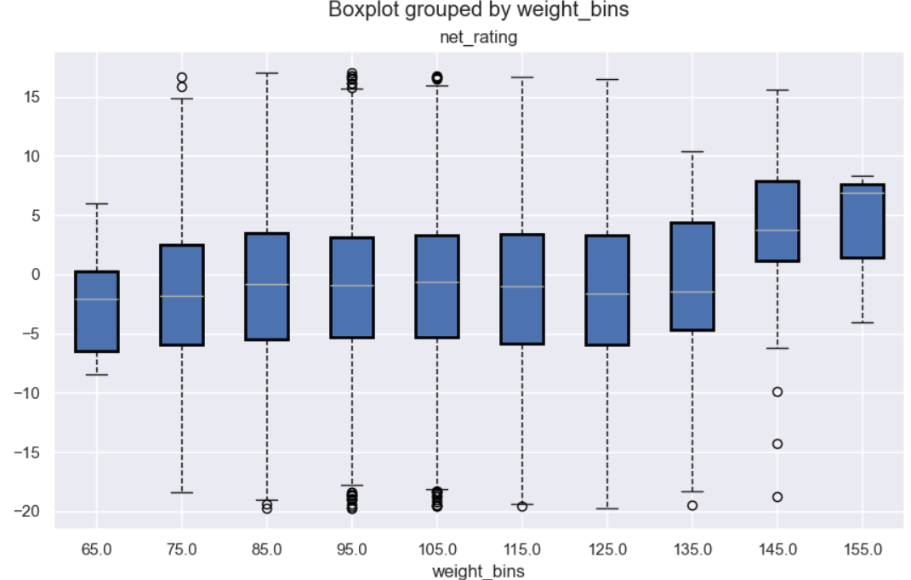
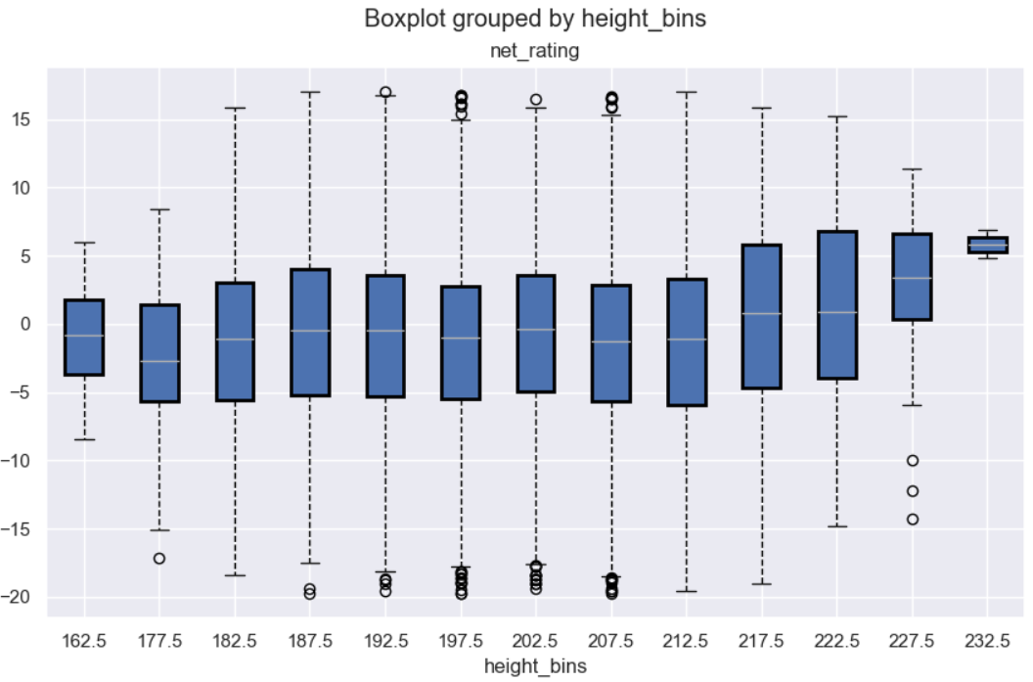
Exploratory Data Analysis
Personal Attributes
Age
Correlation: 0.0071734245789627551
Weight
Correlation:
-0.001742457896275768
Height Correlation: -0.007876105907565819

Slide 12
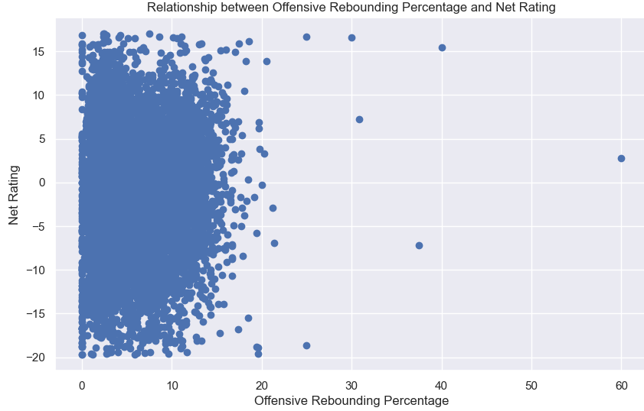
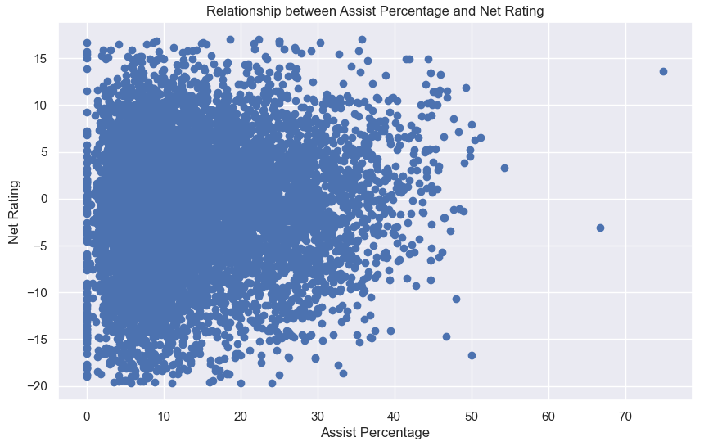
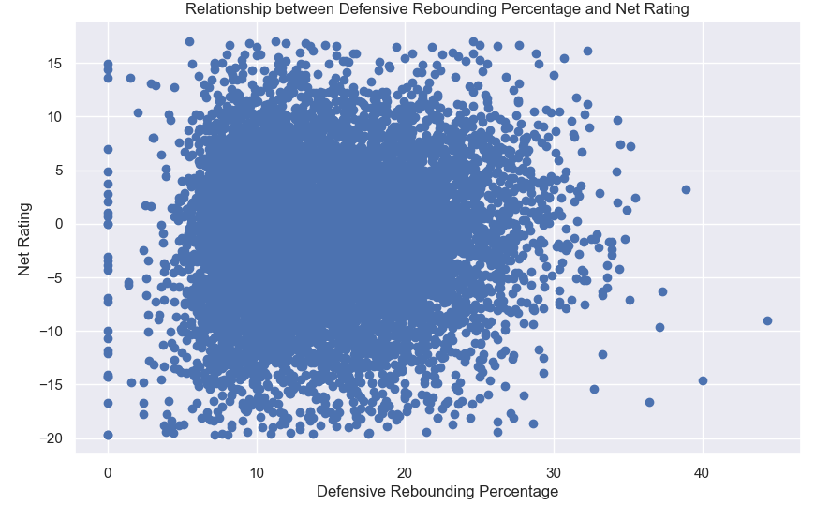
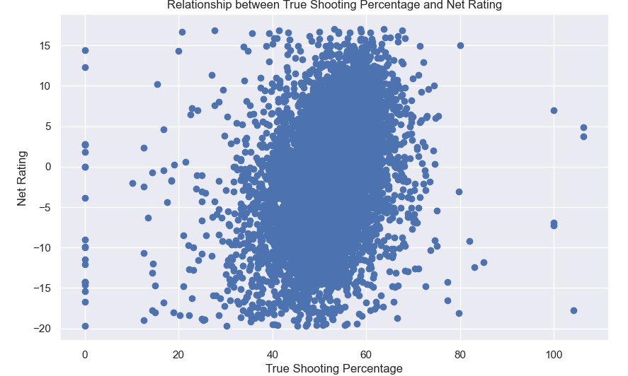
Exploratory Data Analysis
Offensive Rebound %
Correlation:
0.01220721394271988
Assist %
Correlation:
0.109741964371252
Defensive Rebound %
Correlation:
0.0448773466592668
True Shooting %
Correlation:
0.3214180090601262

Slide 13
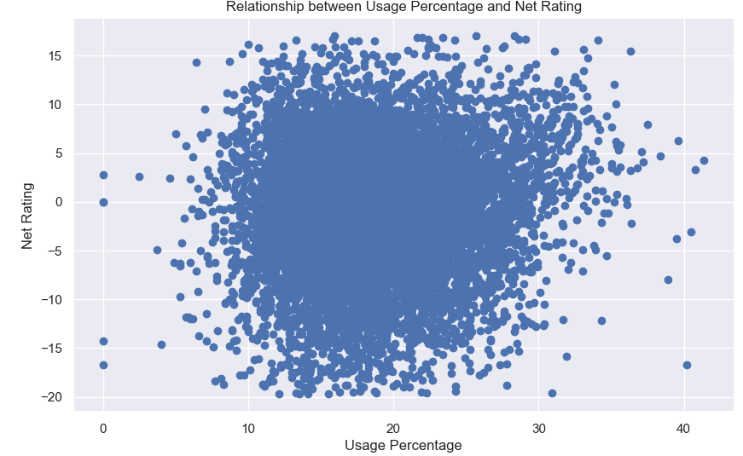
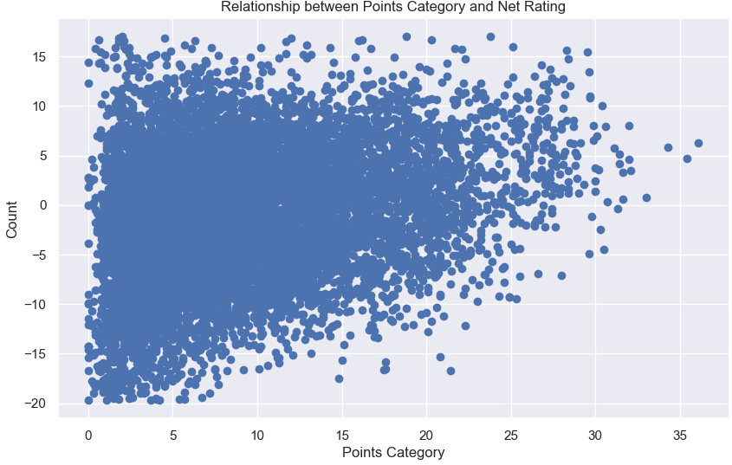
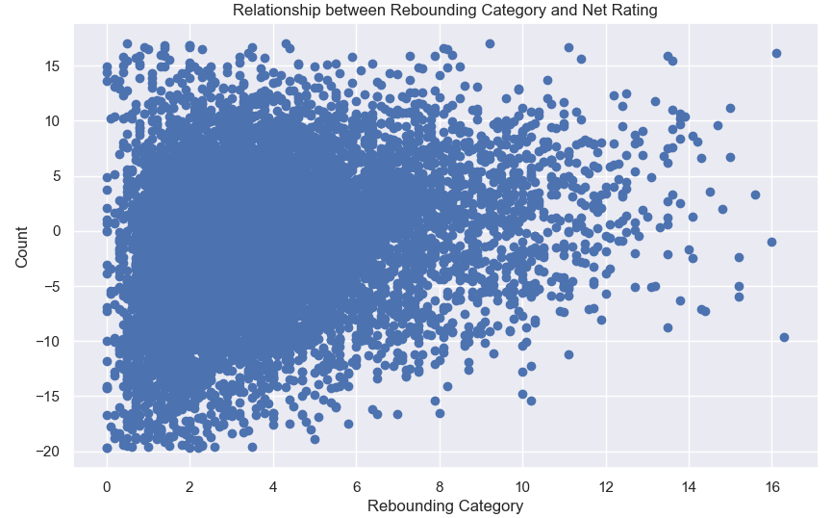
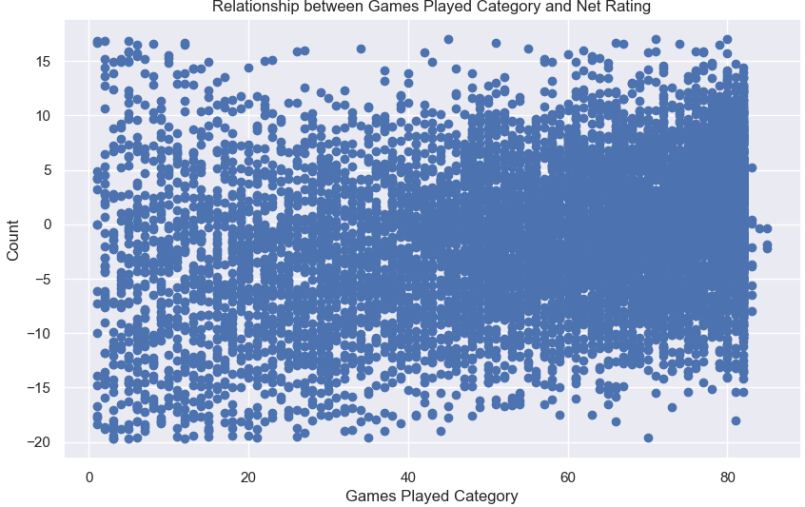
Exploratory Data Analysis
Usage %
Correlation:
0.08185224599295958
Points Scored
Correlation:
0.27275455206084366
Rebound
Correlation:
0.2258208847248855
Games Played
Correlation:
0.271300118544907

Slide 14
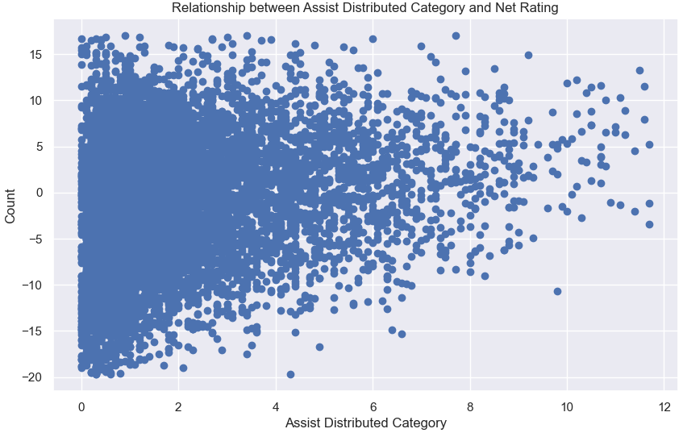
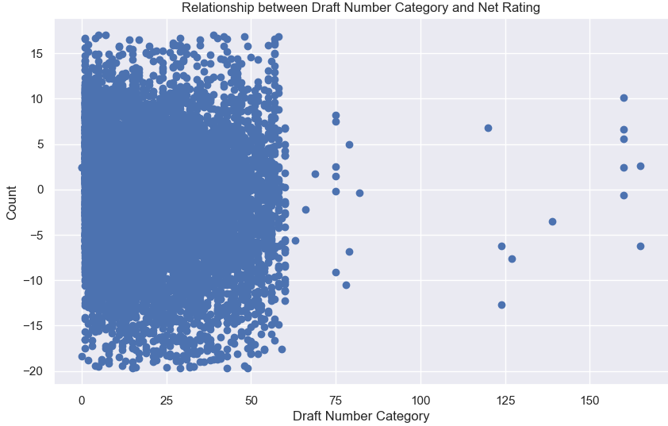
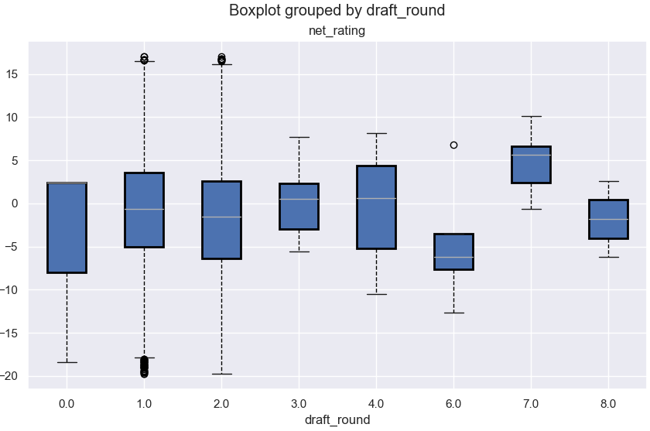
Exploratory Data Analysis
Assist Distributed
Correlation:
0.21695155702767005
Draft Number
Correlation:
-0.075575363427603
Draft Round
Correlation:
-.0.055926817495501456

Slide 15
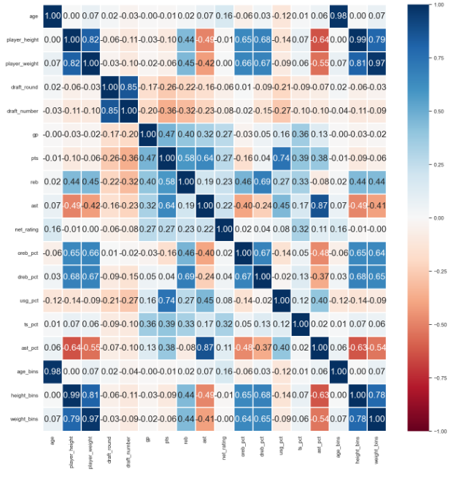
Exploratory Data Analysis
Pearson’s Correlation Coefficient
No distinct linear relationship

Slide 16
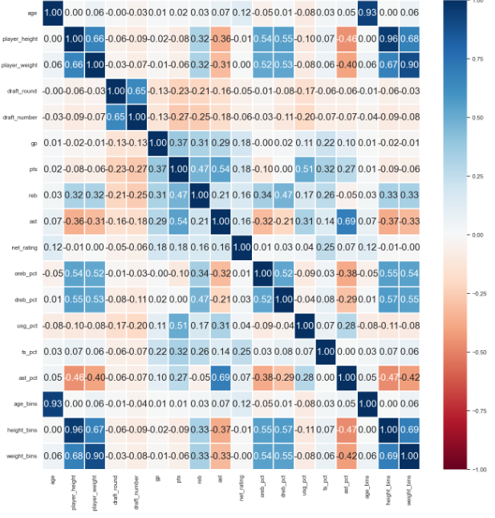
Exploratory Data Analysis
Kendall’s Rank Coefficient
No distinct non-linear relationship

Slide 17
Machine Learning
Mutual Information Regression
Decision Tree Regressor
Cross Validation

Slide 18
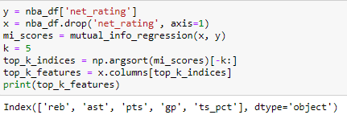
Mutual Information Regression
Why :
Poor correlation between predictor and response
Measures the amount of information that one variable provides about the other variable
Picked out top 5 predictors

Slide 19
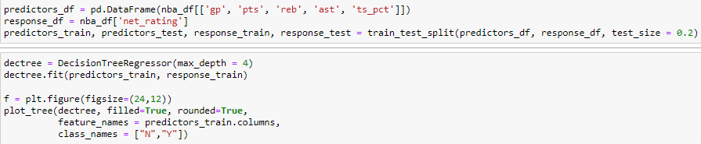
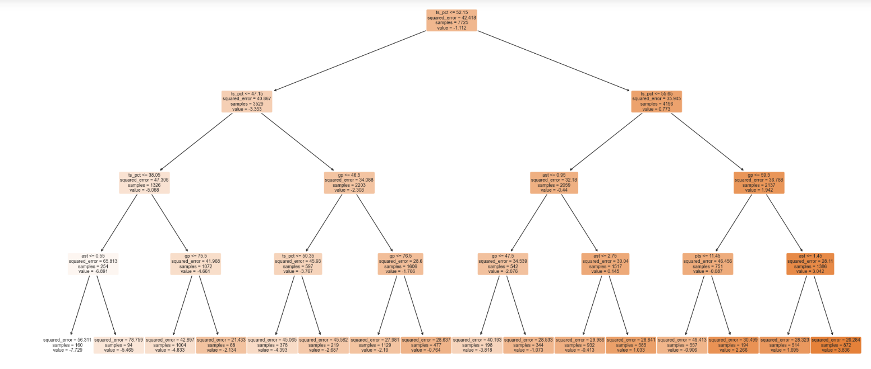
Decision Tree Regressor
Continuous response variable
Effective for poor correlation between predictors and response variables

Slide 20
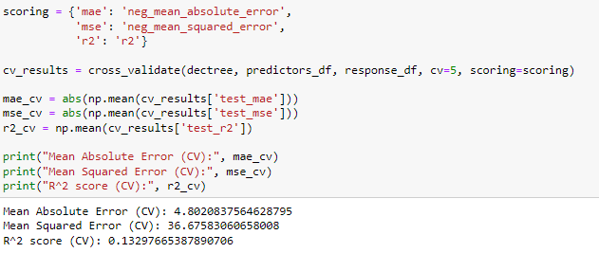
Cross Validation
Reduces the impact of random variations
Provides a more accurate estimate of how well the model is likely to perform

Slide 21
Conclusion / Insights
From our exploratory data analytics and machine learning model, we have found that stats and player features have a poor correlation with net_rating, a direct measurement of a player’s contribution to the team’s performance when the player is on the court.
This goes to show that regardless of how great a player’s individual performance is, it does not mean that the team will be in a winning position.

